Slide 1
9.Voltage Measurement and Display in LCD with ARDUINO
Dr. G. V. Prasanna Anjaneyulu
From
Dr.G.V. Prasanna Anjaneyulu

Slide 2
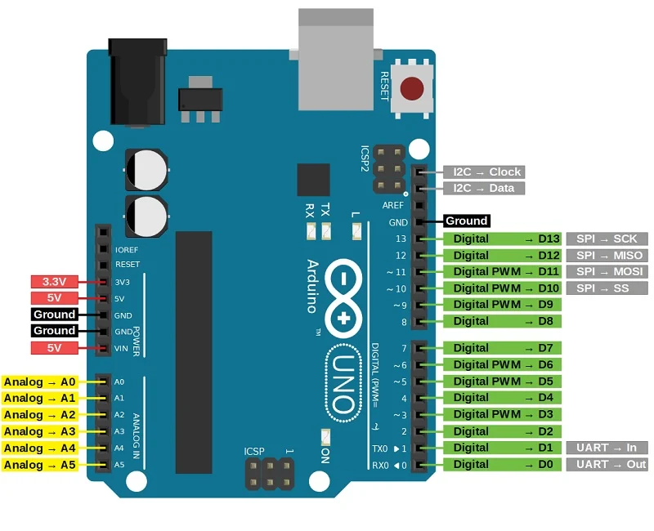
Dr. G. V. Prasanna Anjaneyulu
Voltage_Measurement_Display_in LCD by Dr. GVP

Slide 3
Recap of LCD
Dr. G. V. Prasanna Anjaneyulu
Voltage_Measurement_Display_in LCD by Dr. GVP

Slide 4
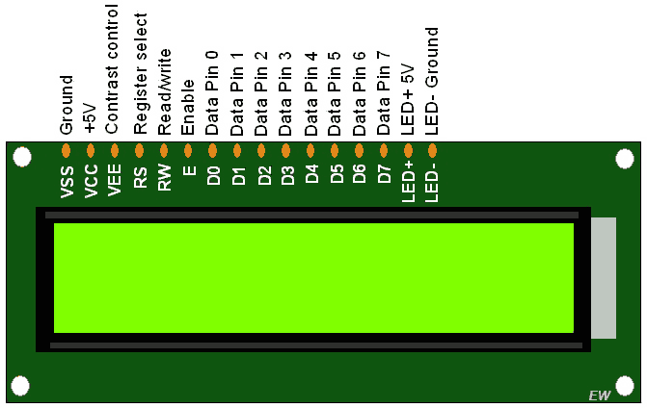
Dr. G. V. Prasanna Anjaneyulu
16 x 2 LCD DISPLAY
Voltage_Measurement_Display_in LCD by Dr. GVP

Slide 5

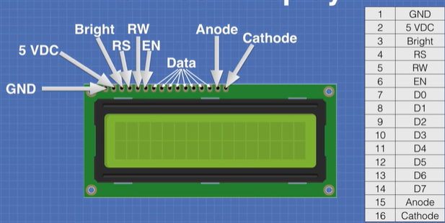
Dr. G. V. Prasanna Anjaneyulu
Voltage_Measurement_Display_in LCD by Dr. GVP

Slide 6
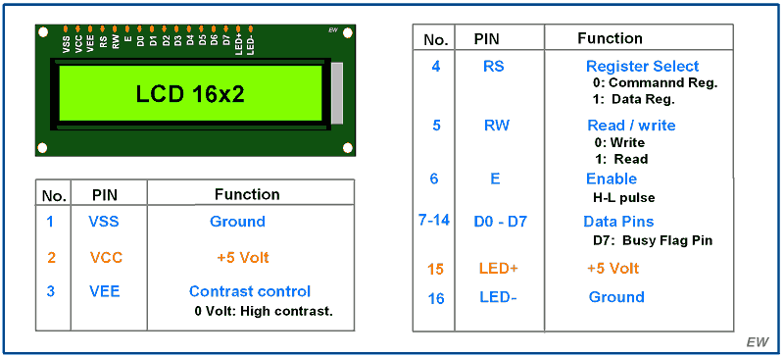
Dr. G. V. Prasanna Anjaneyulu
Voltage_Measurement_Display_in LCD by Dr. GVP

Slide 7
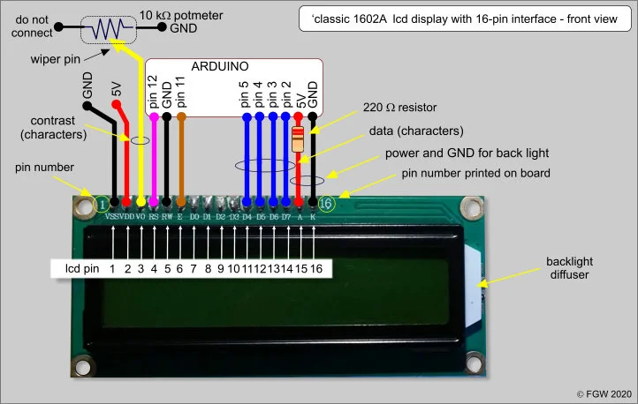
Dr. G. V. Prasanna Anjaneyulu
Voltage_Measurement_Display_in LCD by Dr. GVP

Slide 8
Voltage Measurement Components
1.PC with Arduino IDE
2.Arduino UNO Board
3.USB cable
4.Potentiometer (pot type)
5.Bread board
6.220Ω,30k,7.5k resistors
7. 16*2 LCD
8. 9V battery - connecting terminals
8.Jumper wires
Dr. G. V. Prasanna Anjaneyulu
Voltage_Measurement_Display_in LCD by Dr. GVP

Slide 9
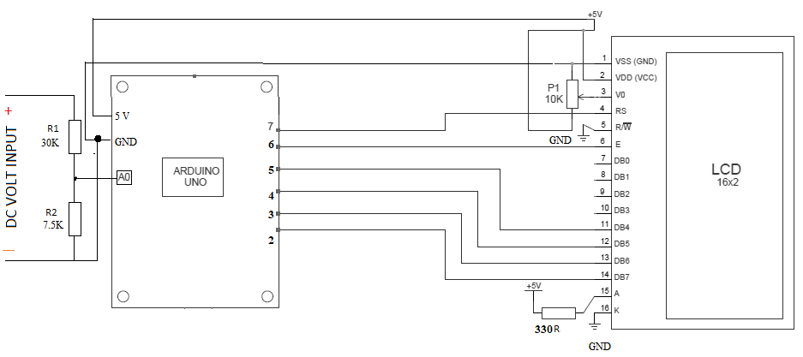
Circuit Diagram
Dr. G. V. Prasanna Anjaneyulu
Voltage_Measurement_Display_in LCD by Dr. GVP

Slide 10
LiquidCrystal lcd(7,6,5,4,3,2);
Dr. G. V. Prasanna Anjaneyulu
Data pins
Enable LCD
Register Select
Voltage_Measurement_Display_in LCD by Dr. GVP

Slide 11
Program
#include "LiquidCrystal.h"
const int voltageSensor = A0;
float vOUT = 0.0;
float vIN = 0.0;
float R1 = 30000.0;
float R2 = 7500.0; int value = 0;
LiquidCrystal lcd(7, 6, 5, 4, 3, 2); // RS, E, D4, D5, D6, D7
void setup()
{
//Serial.begin(9600);
lcd.begin(16,2);
lcd.print(" Measure < 25V ");
delay(2000);
}
void loop()
{
value = analogRead(voltageSensor);
vOUT = (value * 5.0) / 1024.0;
vIN = vOUT / (R2/(R1+R2));
//Serial.print("Input = ");
//Serial.println(vIN);
lcd.setCursor(0,0);
lcd.print("Input = ");
lcd.setCursor(8,0);
lcd.print(vIN);
delay(500);
}
Dr. G. V. Prasanna Anjaneyulu
Voltage_Measurement_Display_in LCD by Dr. GVP

Slide 12
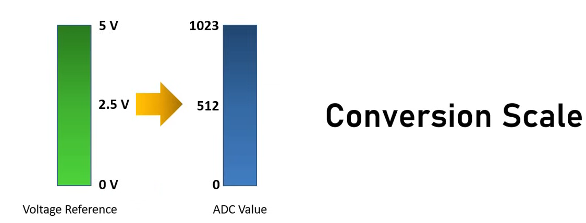
Dr. G. V. Prasanna Anjaneyulu
Voltage_Measurement_Display_in LCD by Dr. GVP

Slide 13
note:
In tinkercad voltage sensor not available so potential divider used with resistors
ATmega have inbuilt 10 Bit ADC so its value in digital format of 0 to 1023 for a voltage of 0 to 5V
To convert to normal form multiplication factor 5/1024 used
Dr. G. V. Prasanna Anjaneyulu
Voltage_Measurement_Display_in LCD by Dr. GVP

Slide 14
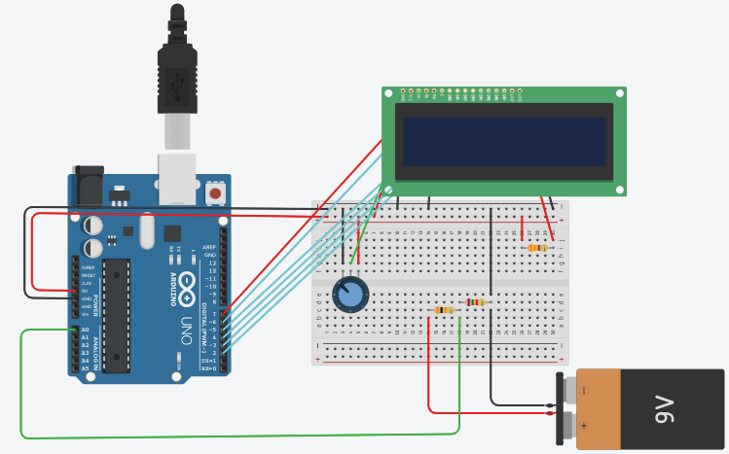
Implementation in TINKERCAD
Dr. G. V. Prasanna Anjaneyulu
Voltage_Measurement_Display_in LCD by Dr. GVP

Slide 15
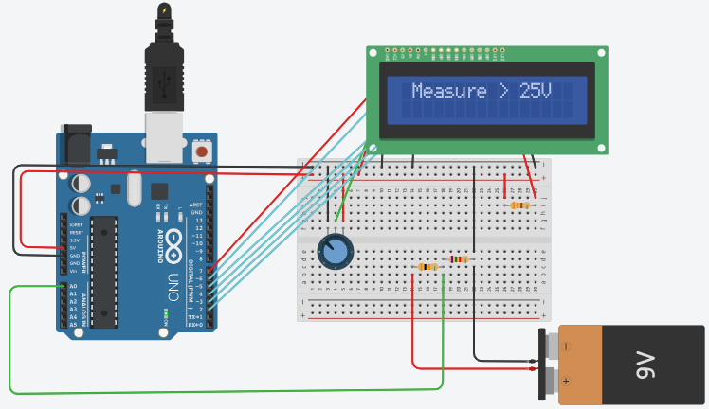
Execution……
Dr. G. V. Prasanna Anjaneyulu
Voltage_Measurement_Display_in LCD by Dr. GVP

Slide 16
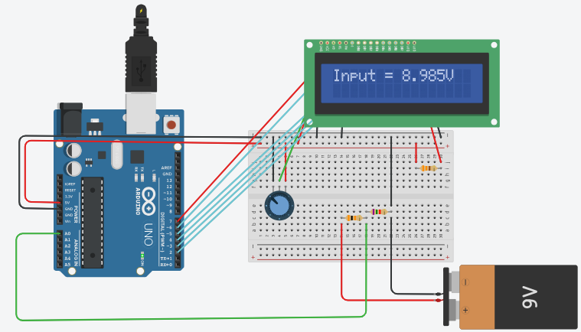
Results…..
Dr. G. V. Prasanna Anjaneyulu
Voltage_Measurement_Display_in LCD by Dr. GVP

Slide 17
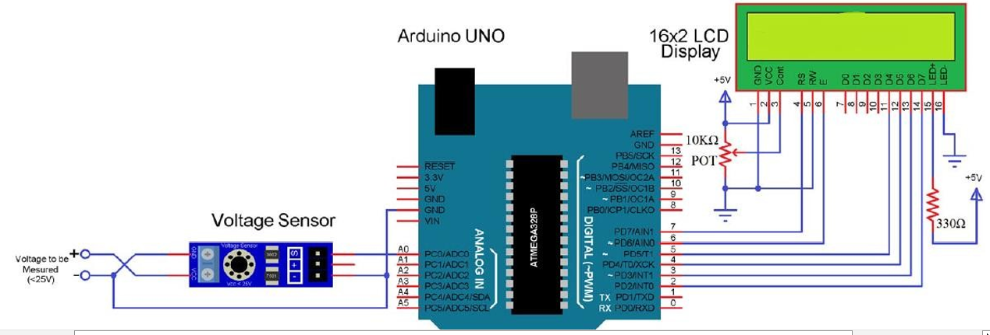
Implementation in LAB (with Voltage Sensor)
Dr. G. V. Prasanna Anjaneyulu
Voltage_Measurement_Display_in LCD by Dr. GVP

Slide 18
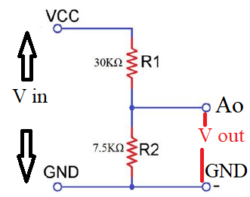
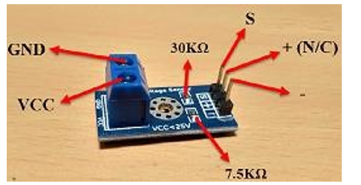
Voltage sensor
Functionally it is same as potential divider with two resistors 30k, 7.5k as shown in figure [note: N/C —- No connection]
Dr. G. V. Prasanna Anjaneyulu
Voltage_Measurement_Display_in LCD by Dr. GVP

